Slide 1
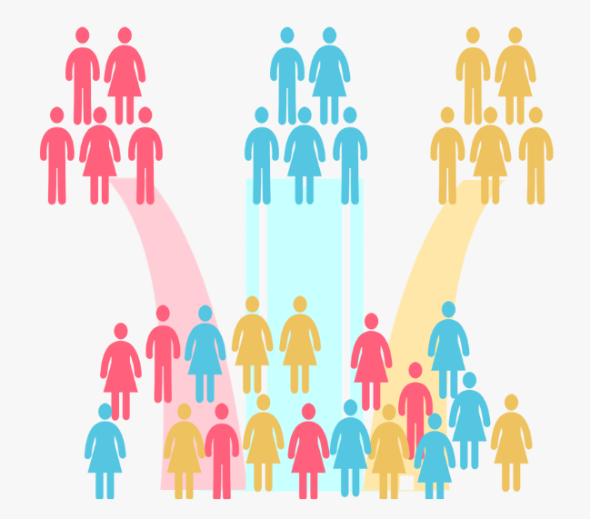
Customer Segmentation
using
K-Means Clustering
with Python
Machine Learning Projects

Slide 2
